Slide 1
TEMPORARY SLIDE
WHO IS DOING WHAT?
TOM - (1) Introduction of group and project, (2) lit review summary, (5) design evaluation, (11) future works
CAM - (3) Design strategy, (4) design iterations,
AMANDA - (7) critical calculations including gear dimensions, forces etc, (6) design assumptions
RITA - (8) FMEA (9) FEA thing, (10) animation

Slide 2
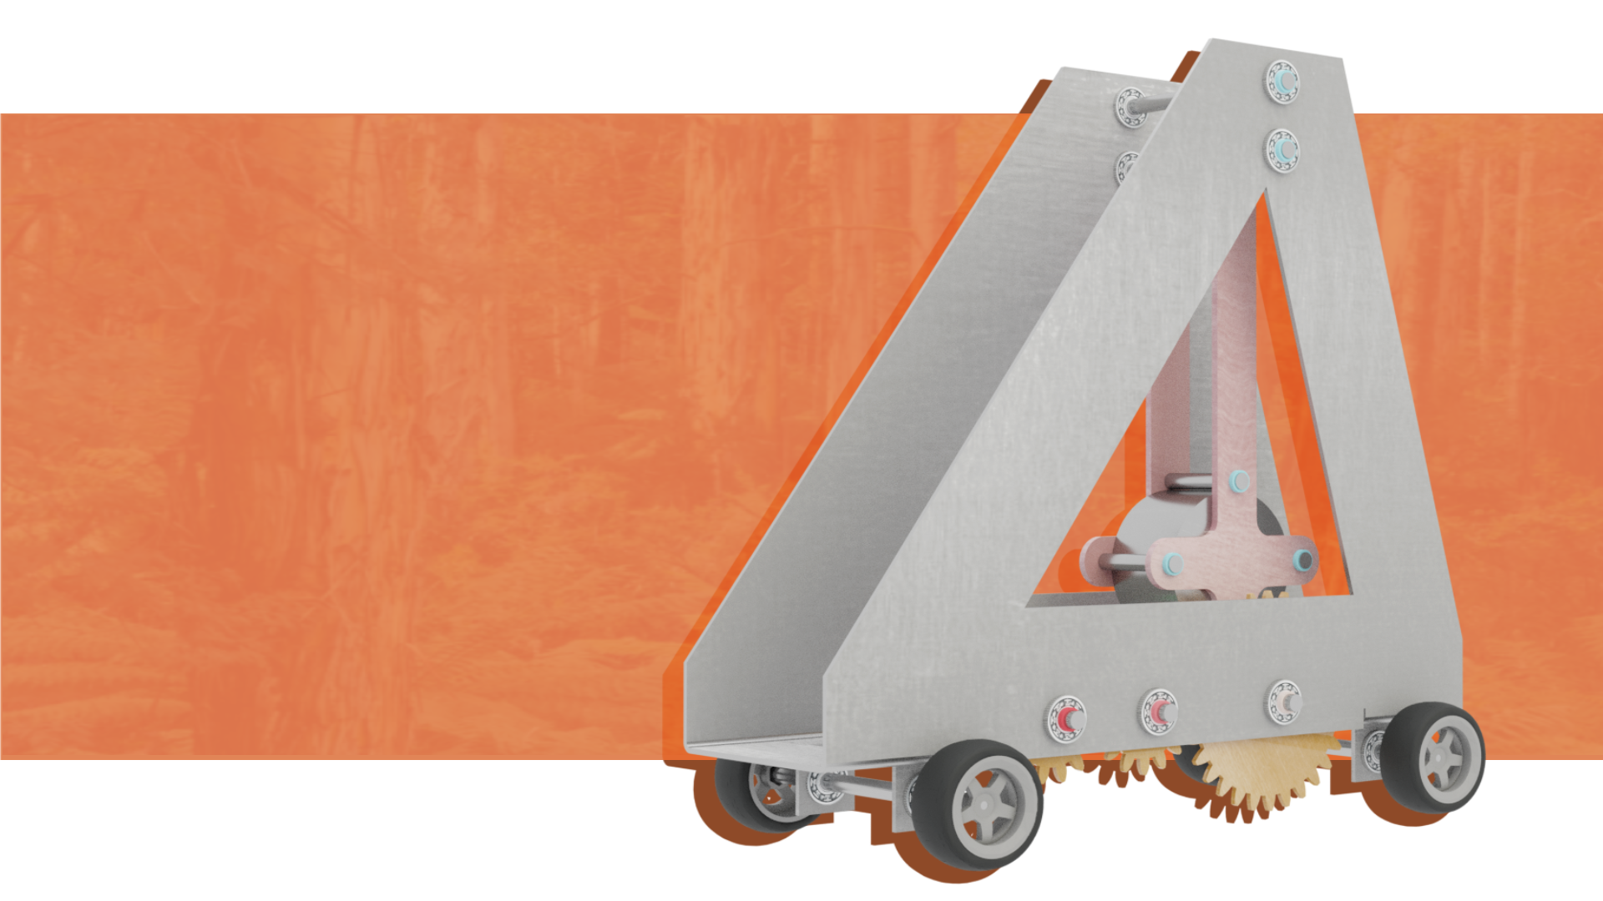
GRAVITY CAR PROJECT
Tom McIlvenna
Rita Uy
Campbell Larkman
Amanda Tang

Slide 3
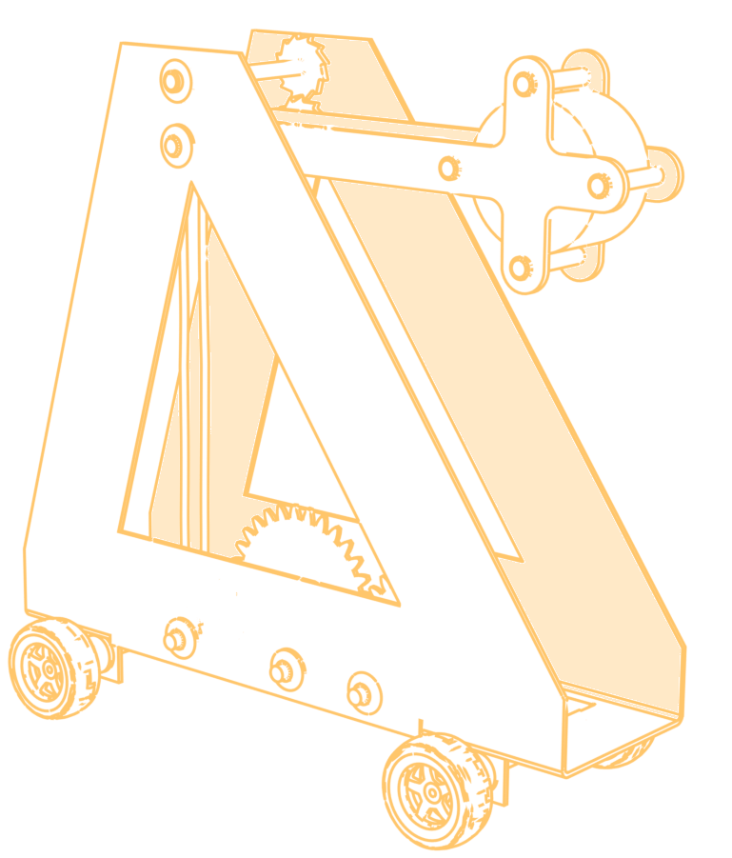

ABOUT THE PROJECT
01
02
DESIGN APPROACH & CONCEPT SELECTION
TABLE OF CONTENTS
03
FORCE ANALYSIS
04
FMEA & FEA
05
ANIMATIONS

Slide 4


Mission Statement
‘To design an efficient and effective vehicle that featured a unique method of energy transfer’

Slide 5

Research
Necessary theories surrounding conservation of energy and likely sources of energy dissipation
Background information on different material types and their properties
Required mechanisms to transfer and control energy transfer from mass to wheels

Slide 6
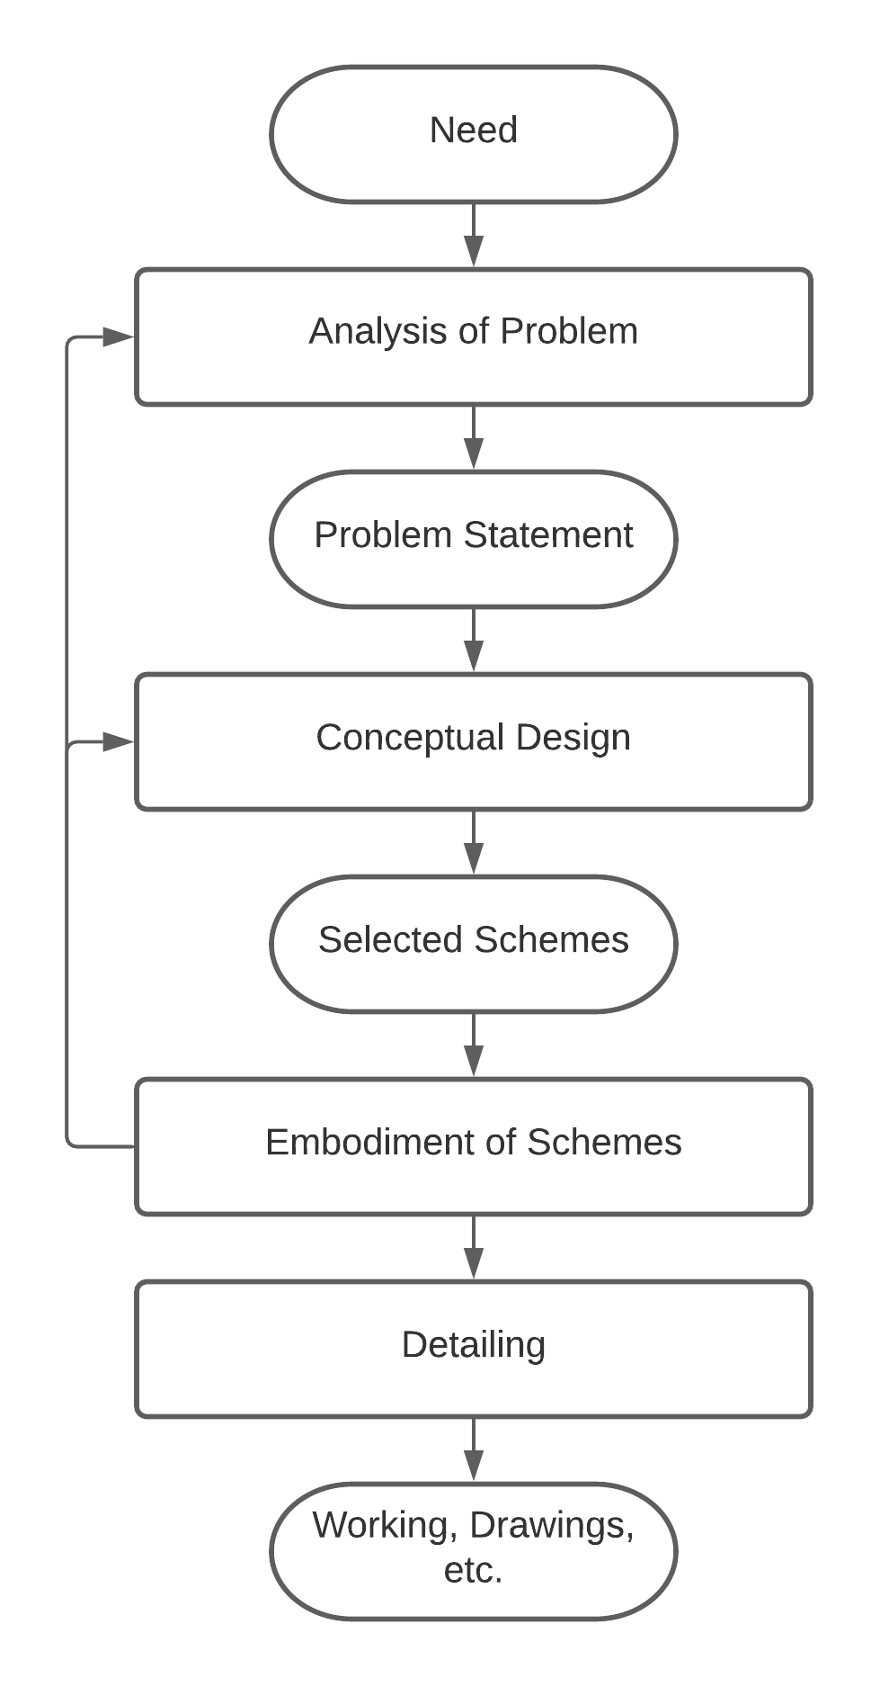
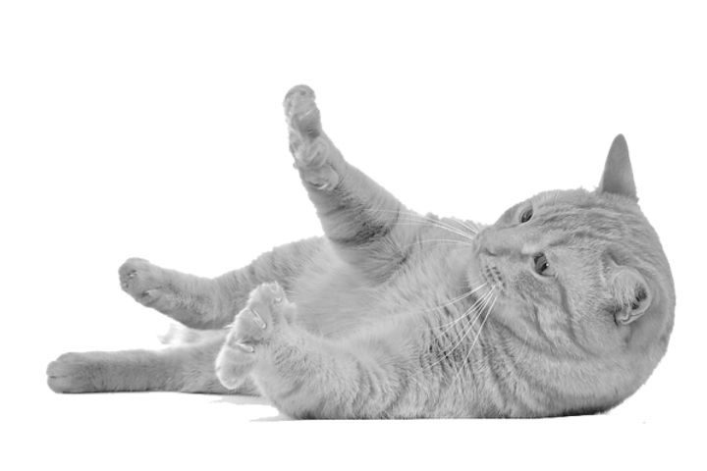
Design Approach:
French’s Model
Simple approach
Easy to follow
Continuous feedback loop
Figure - French’s Model

Slide 7
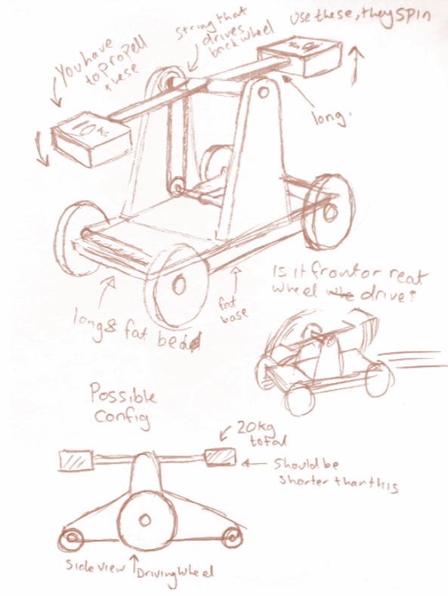
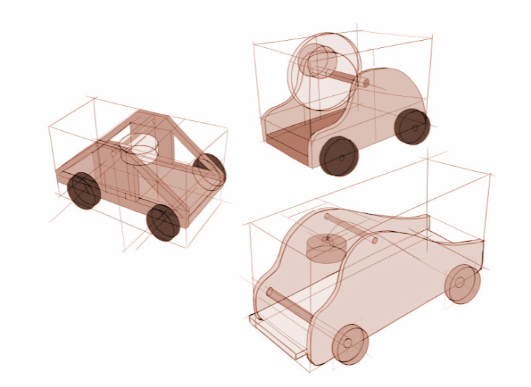
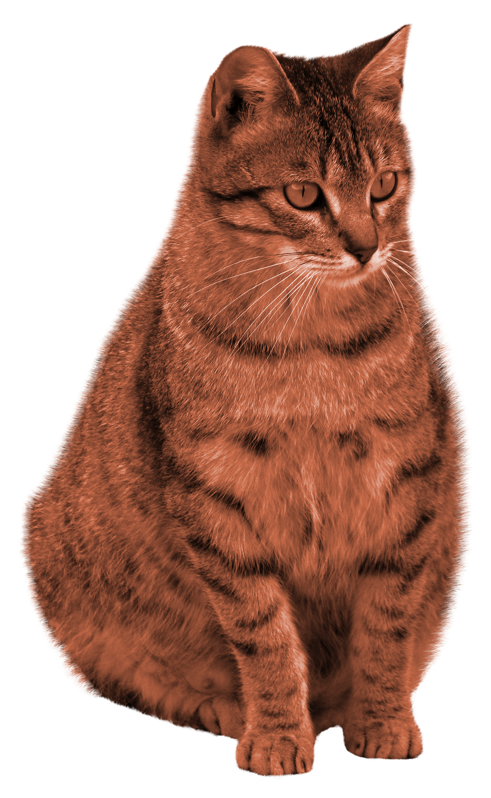
Initial Concepts
Each team member submitted multiple ideas with different energy transfer methods using 4-3-5 methods
Team discussed each design’s virtues and flaws until we settled on two ideas we thought were best

Slide 8
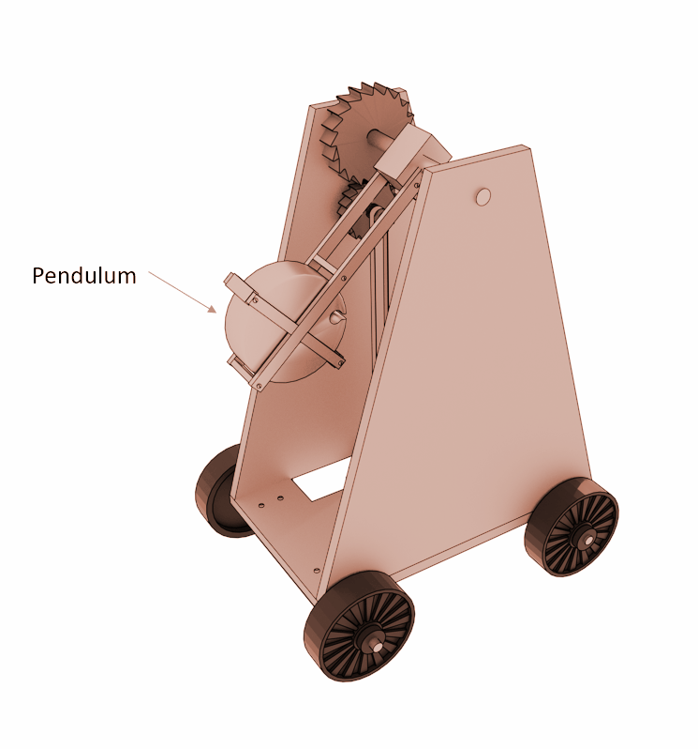

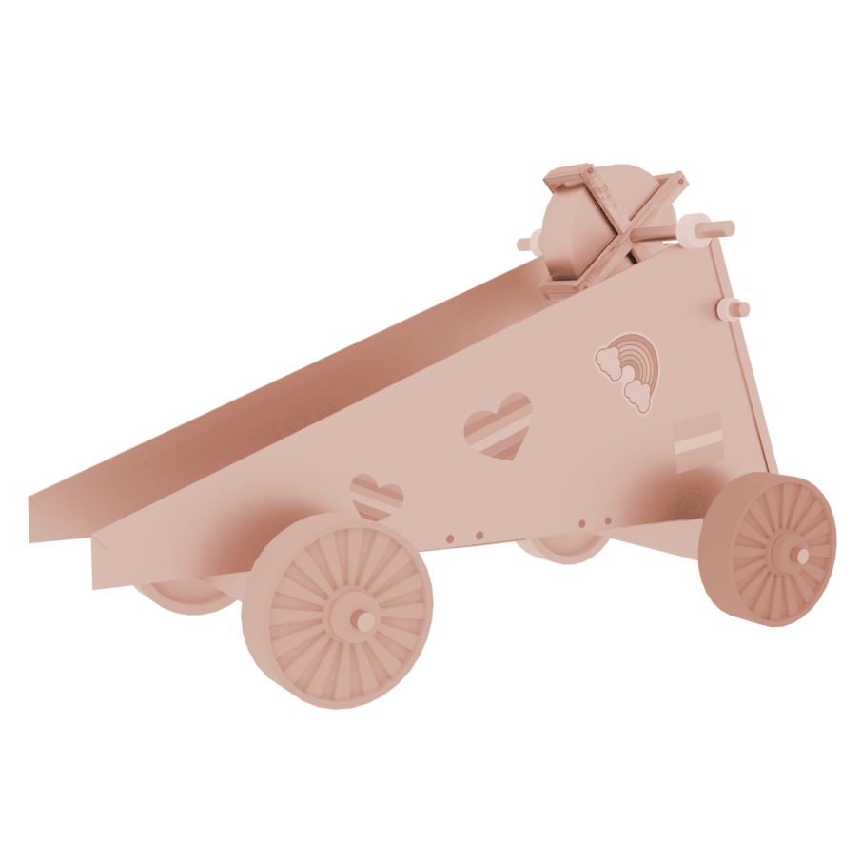
Top Two Designs
Decided that pendulum concept was good as we could use the inertia from the pendulum arm to further power the vehicle
Ramped concept was good as it was a long term method of deploying energy

Slide 9
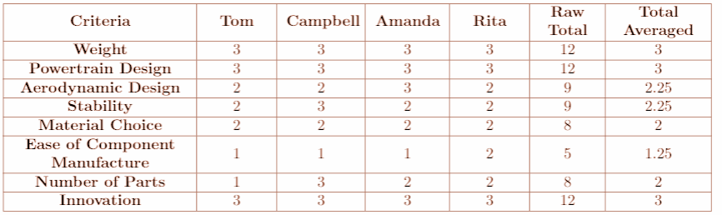
Design Criteria Weighting
Four key categories:
Energy Usage
Vehicle mass
Powertrain efficiency
Aerodynamic efficiency
Vehicle Dynamics
Stability
Structural integrity
Manufacturability
Ease of component manufacture
Number of parts
Innovation
We individually voted on how important these criteria were to us
Scores were averaged to determine the weighting of each criteria

Slide 10
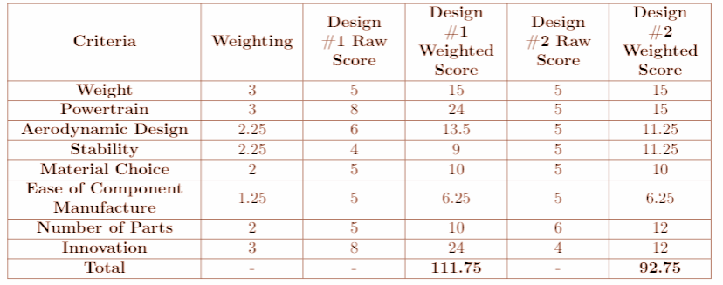
Design Evaluation
As a team we compared both designs against each criteria and agreed on a score out of ten
We then multiplied these raw scores against our weighting to calculate a weighted score
The design with the highest weighted score would be continued
It was determined that the pendulum was the superior option

Slide 11
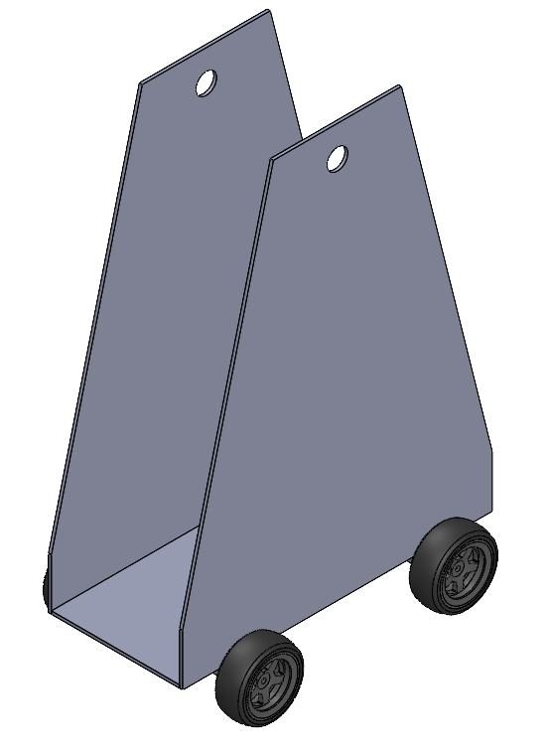
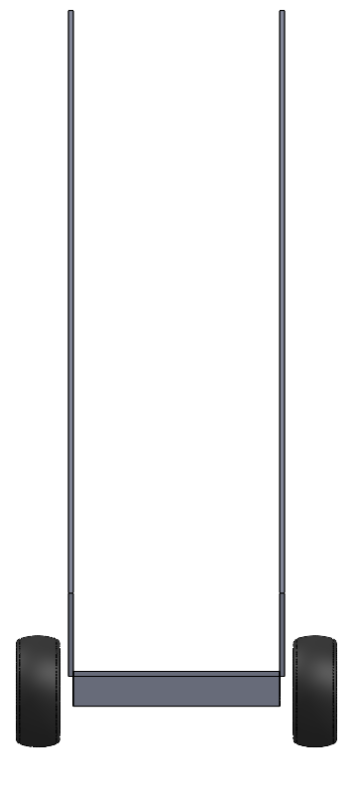
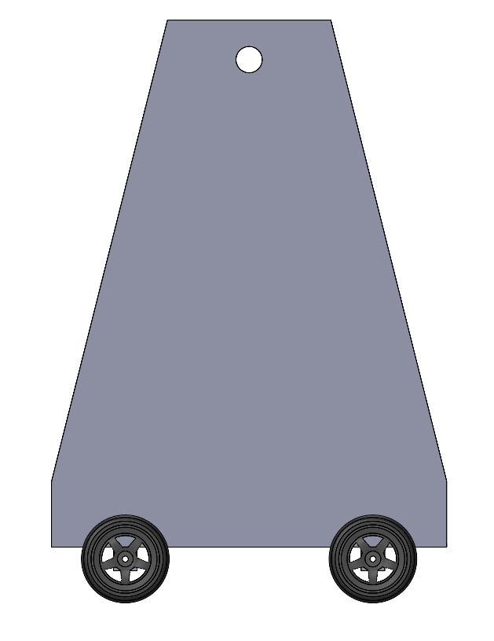
First Design Iteration
Front View
Side View

Slide 12
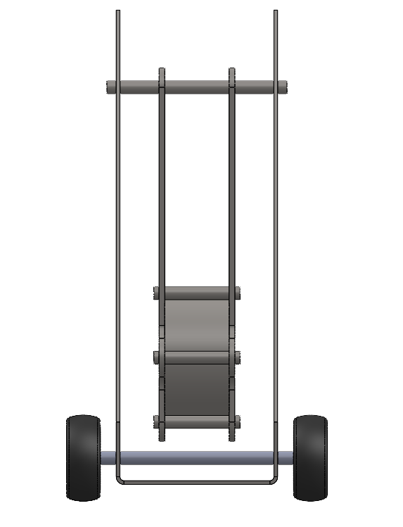
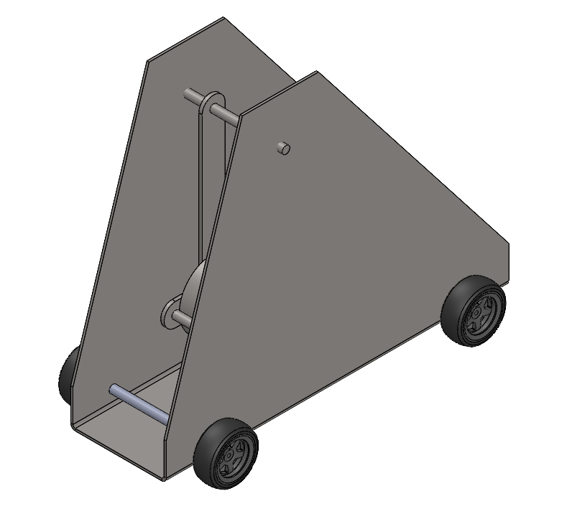
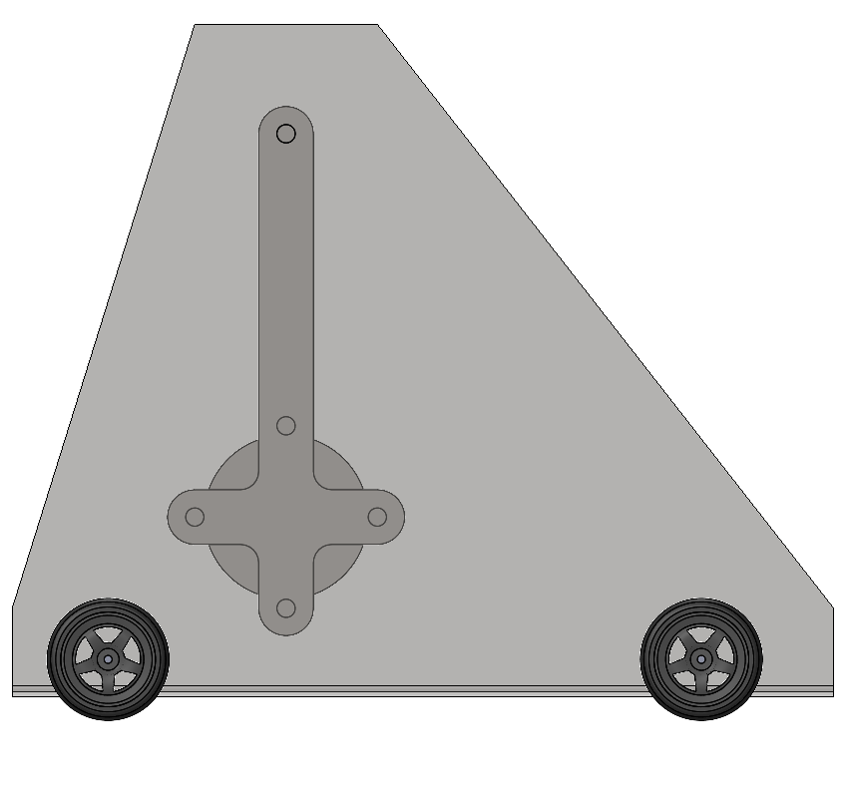
Second Design Iteration
Front View
Side View

Slide 13
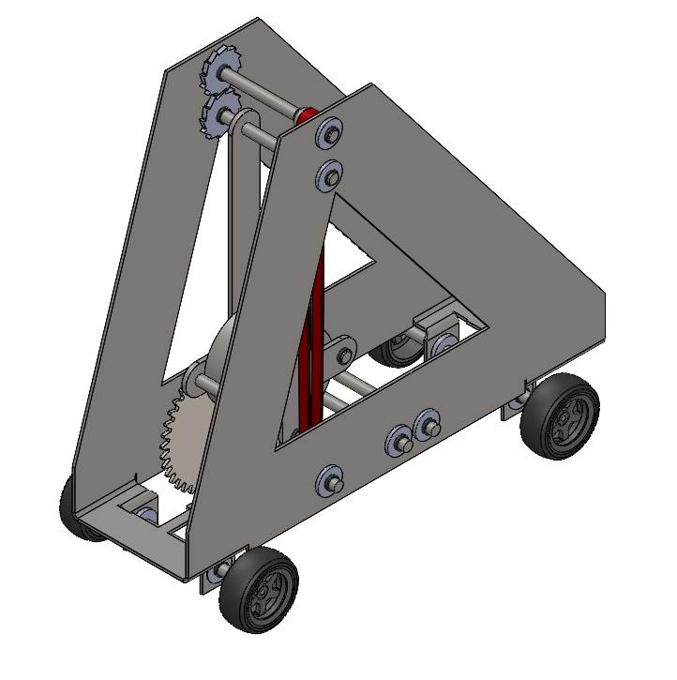
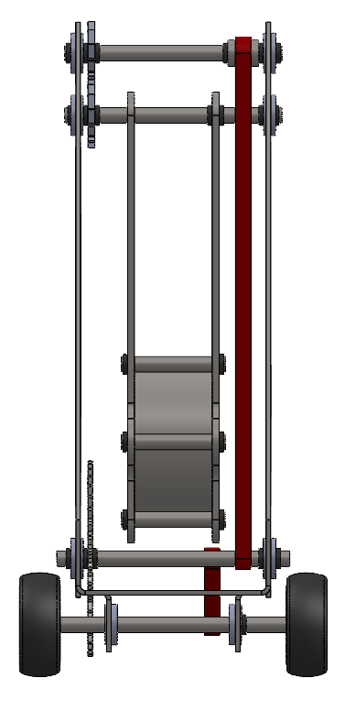
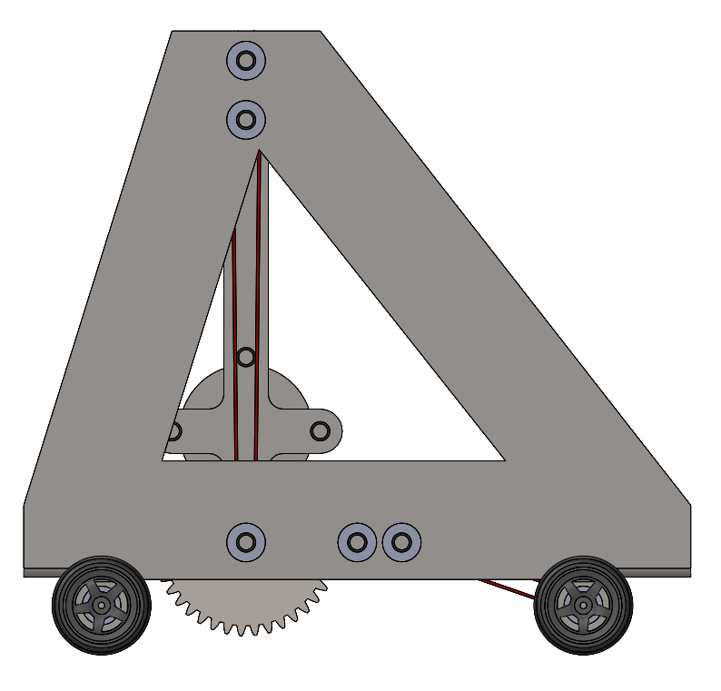
Third and Final Design Iteration
Front View
Side View

Slide 14
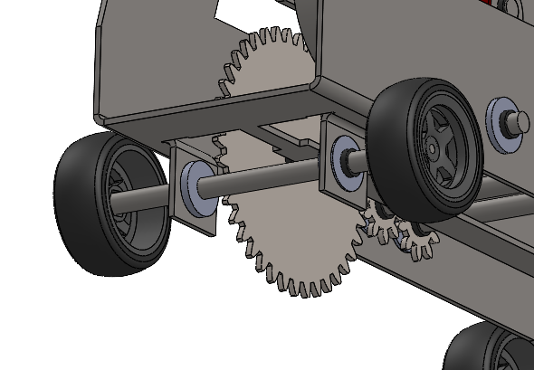
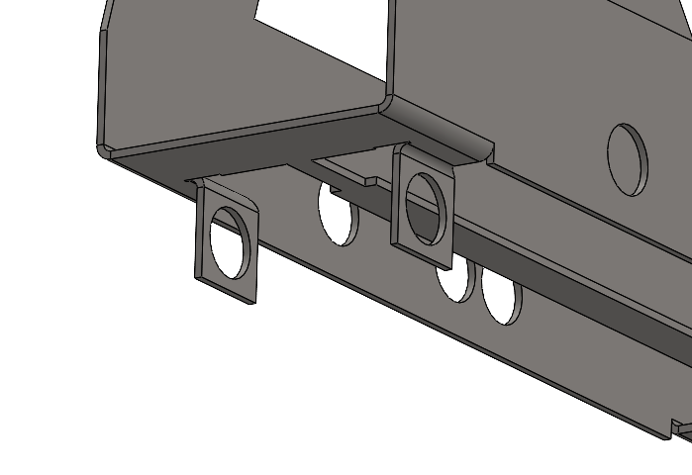
Third and Final Design Iteration
Sheet Metal Flap Bends
Sheet Metal Frame

Slide 15
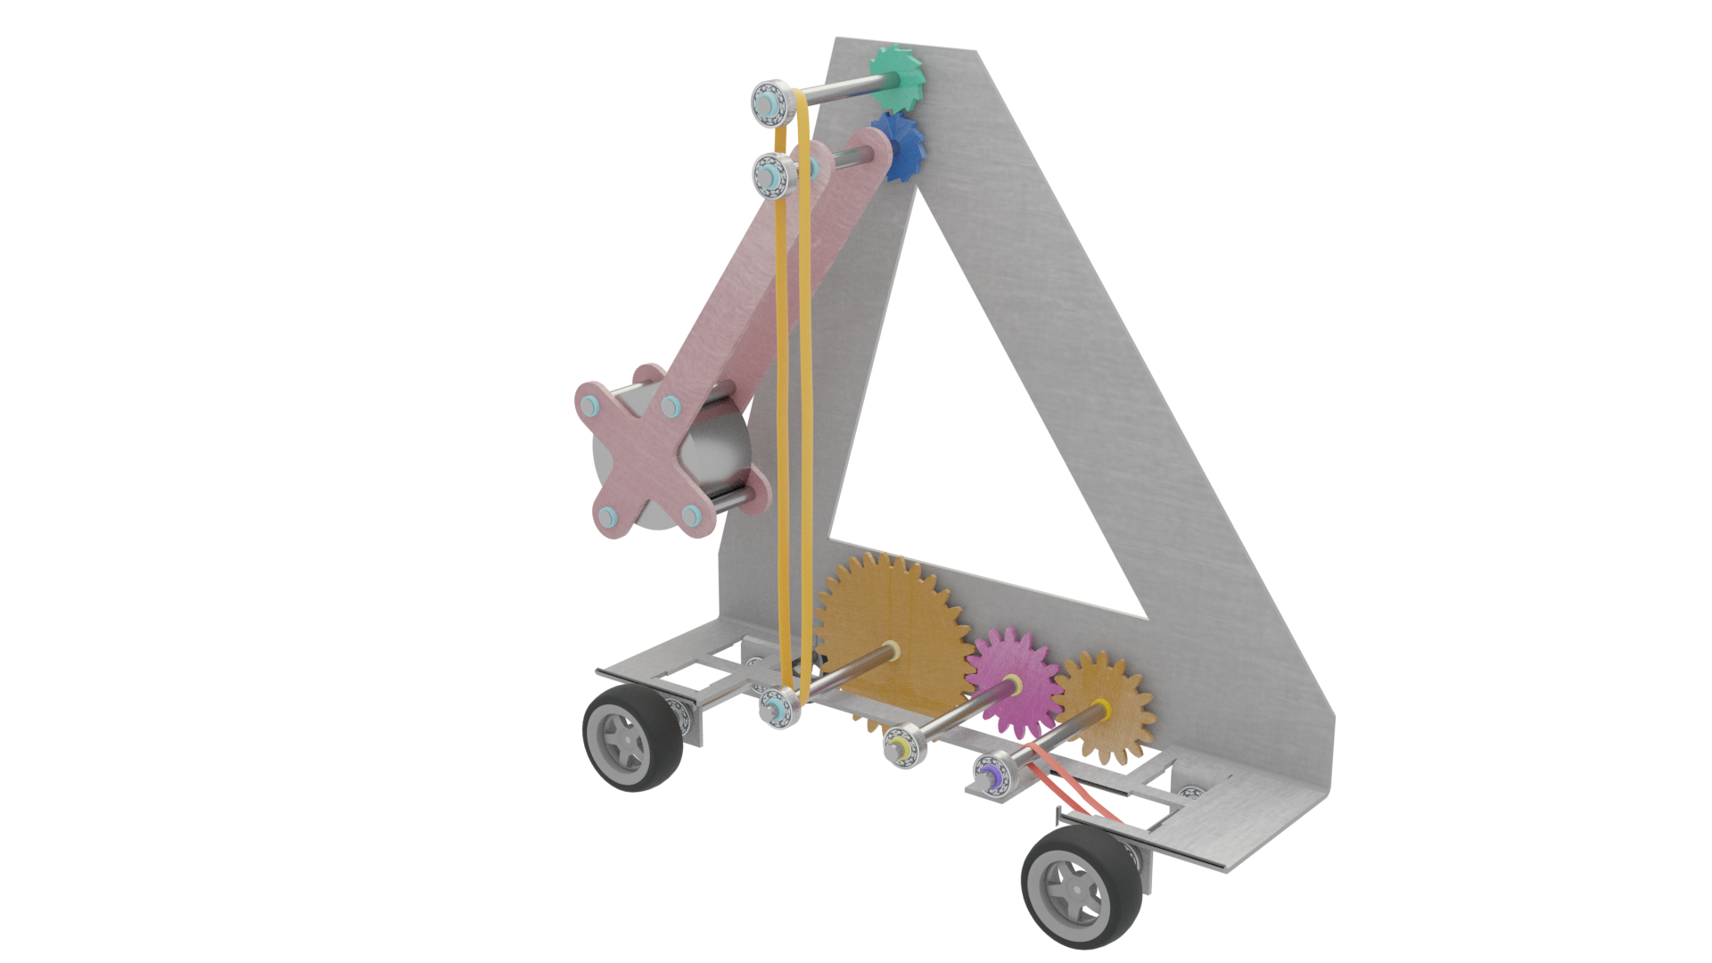
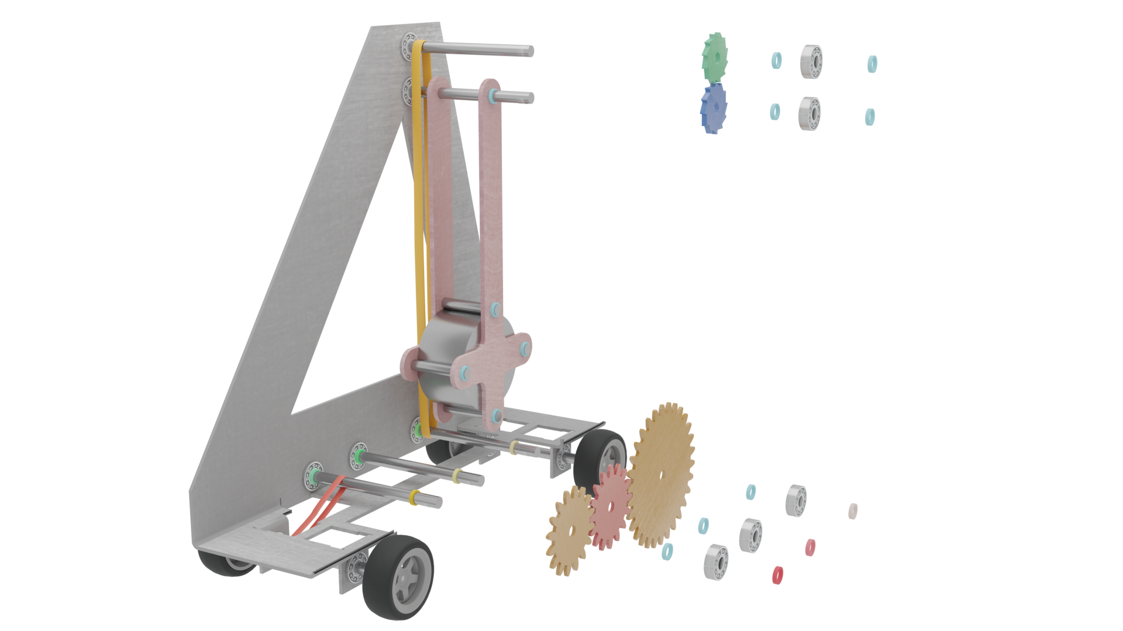
About the design
RATCHET GEARS
Bearings to make movement easier
Pulley bands to take the energy of the pendulum to the axles.
Bands in the lower section to propel the wheels
All parts held together with bands

Slide 16
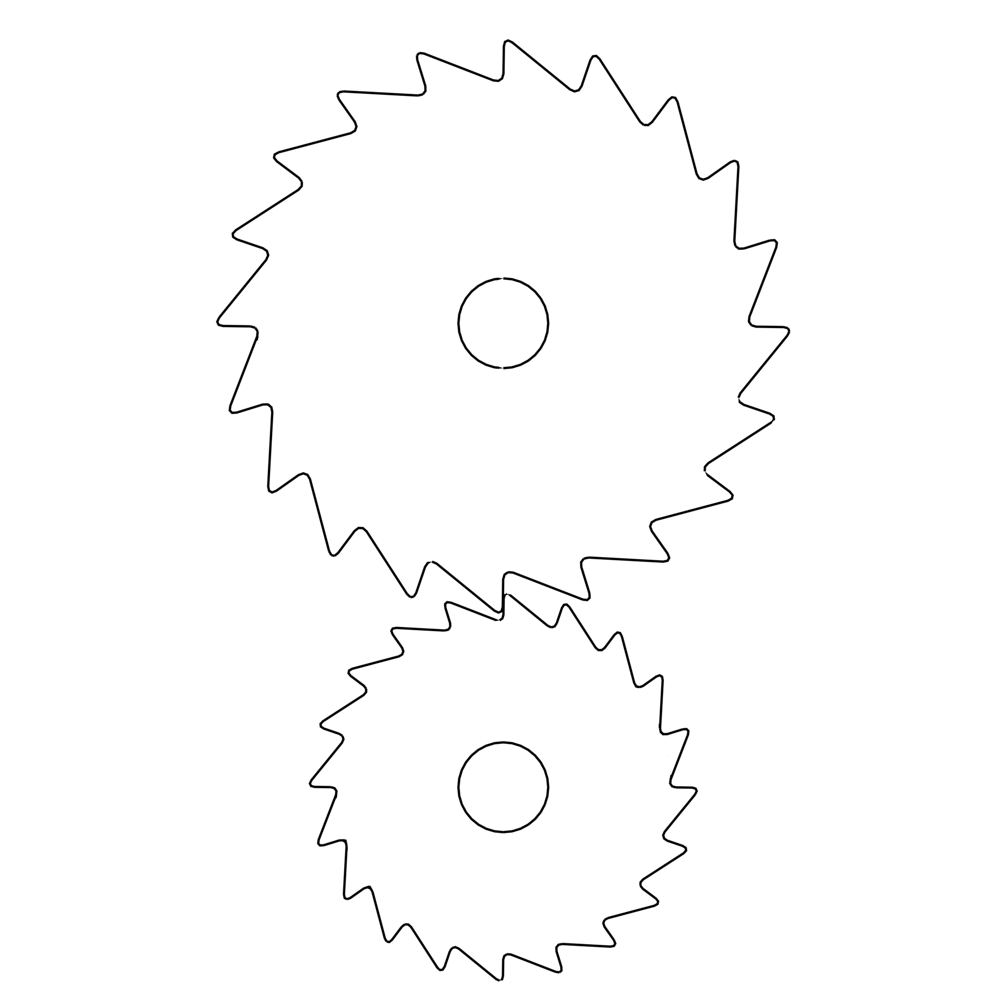

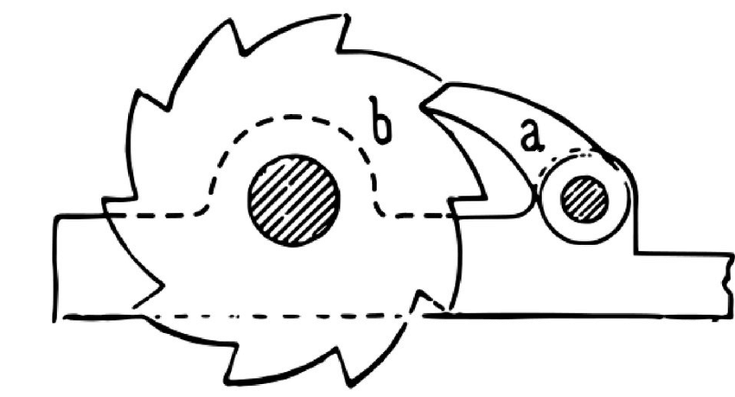
About the design
Difficult to animate slippage but you can see how it is supposed to work
Mikhailovsky, George. (2019). Structuredness as a Measure of the Complexity of the Structure and the Role of Post-Dissipative Structures and Ratchet Processes in Evolution. 10.20944/preprints201904.0292.v1.

Slide 17
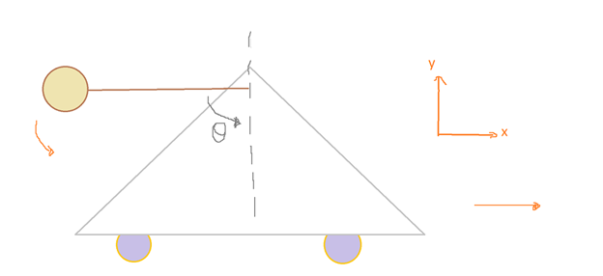
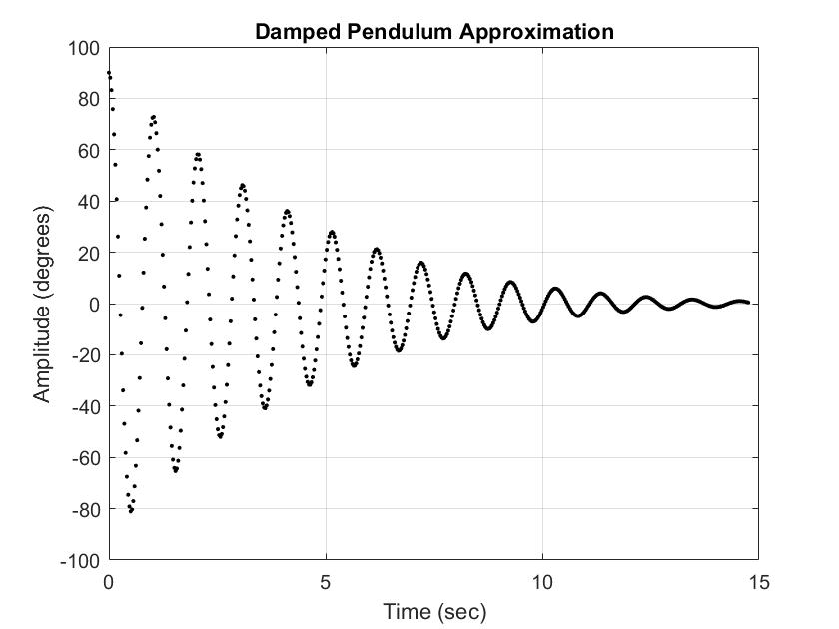
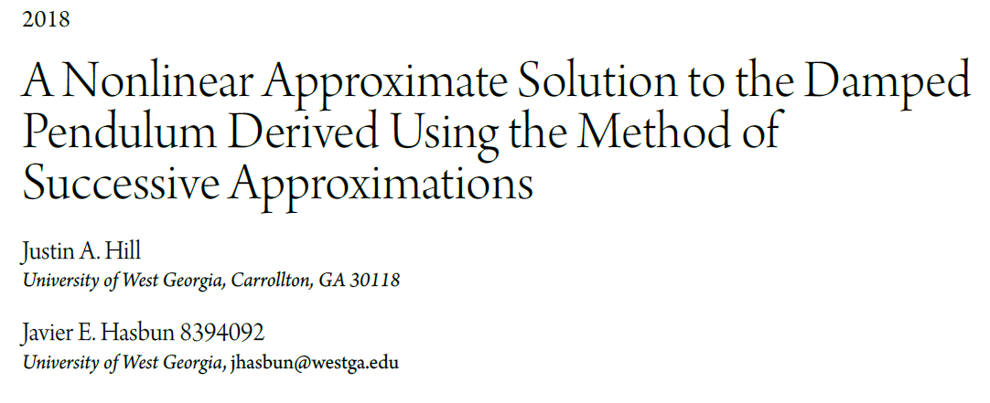
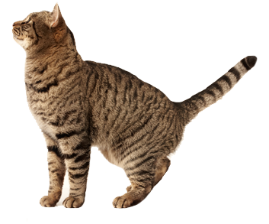
Pendulum Motion
2D Pendulum
Damped harmonic motion
Air resistance approximated as linear viscous force
Calculate period to determine forces on components - oscillating forces
Notes:
The pendulum was approximated as a 2D planar pendulum restricted to the x-y (horizontal and vertical) plane
The damping was due to air resistance acting on the weight as the pendulum swings back and forth
Damped pendulum motion is complicated to model and only numerical solutions exist, I was lucky to find a report that analysed numerical solutions for that system and used one of their methods to analyse the car. The plot showing the pendulum’s behaviour was obtained by putting in initial values specific to our scenario such as mass and length of the pendulum arm. It can be seen in the plot on the slide that the pendulum motion is damped out almost completely after about 11 seconds.
From there, the motion of the pendulum and its period of oscillation can be translated to other components on the car.

Slide 18
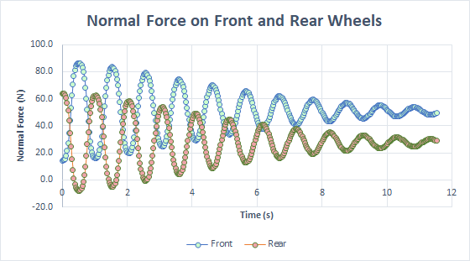
Force Analysis
Assumptions
Friction in bearings negligible
No force on ratchet gears when pendulum swings ‘back’
Ratchet gears approximated as involute spur gears in terms of force analysis
Axial forces on components neglected
100% Efficiency assumed between components
Notes:
Because of the complexity of the model, many assumptions were taken to analyse the model. Mostly neglecting friction in the bearings and assuming 100% efficiency between components
The plot on the right shows the normal force on the front and rear wheels – this is useful for calculating the expected stability of the vehicle
If the normal force is less than zero, that indicates the car will fall over, this is seen in the plot where the normal force on the rear wheel does reach negative values and indicates that the stability needs to be increased through the design. It is helpful to evaluate the stability of model after any changes.

Slide 19
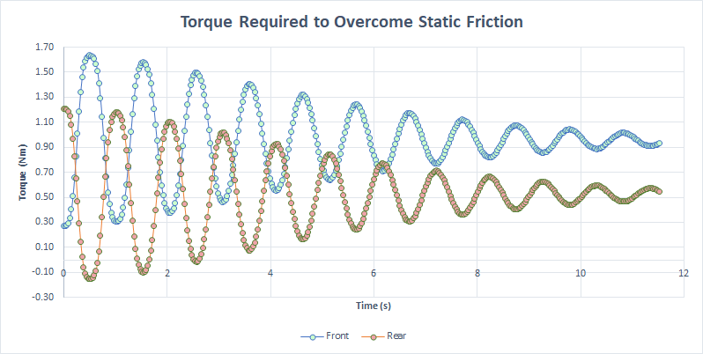
Force Analysis
Notes:
The Torque required to overcome static friction can also be calculated for the front and rear wheels where the coefficient of friction was approximated as being rubber on concrete. It can also be understood that the car will stop moving when the torque from the pendulum is lower than the required maximum torque, and further analysis is require to see when this is reached

Slide 20
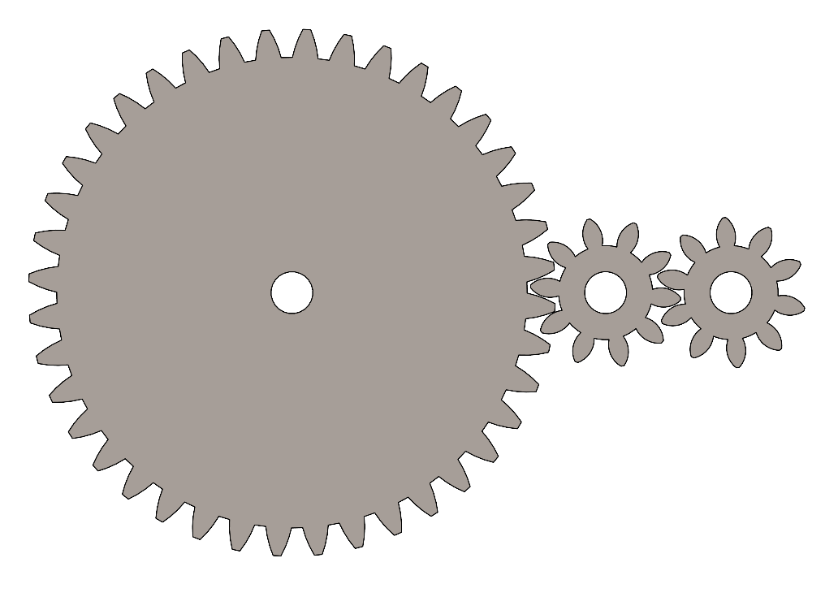
Gear Selection
 | Pinion | Idler Pinion | Gear
Ratio | 1 | 1 | 4
Pitch diameter (mm) | 30 | 30 | 120
Number of Teeth | 10 | 10 | 40
Module | 3 | 3 | 3
Notes:
The gears used in this car are a set of gears at module 3. The design was based on the spatial constraints of the car, and the ease of manufacturing the spur gears. The ratio was chosen to deliver a large torque transfer.

Slide 21
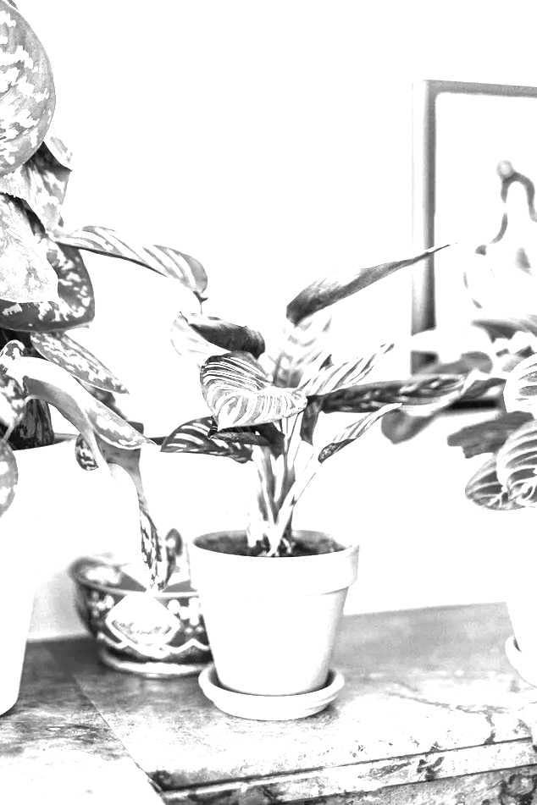
FAILURE MODE AND EFFECT ANALYSIS
Finding all possible points of failure
The cause and effect analysis
Severity ratings

Slide 22
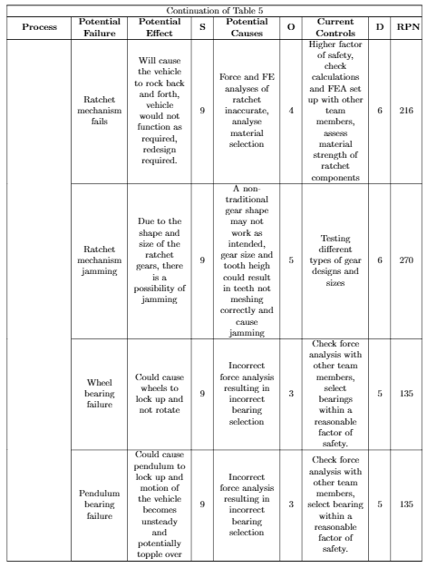
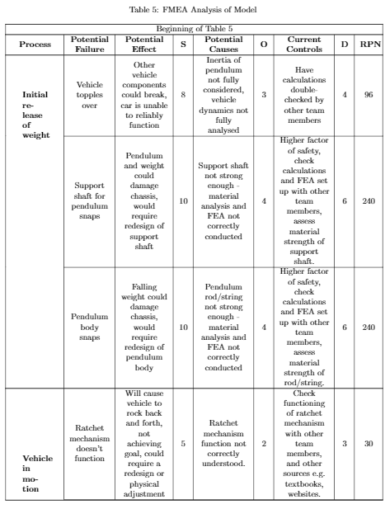
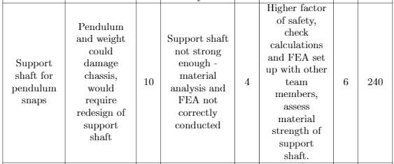
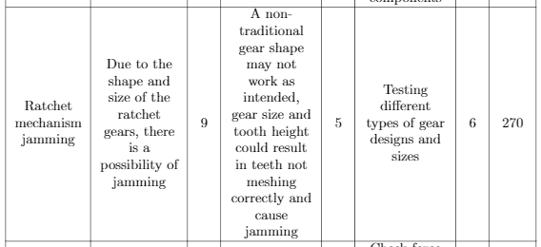
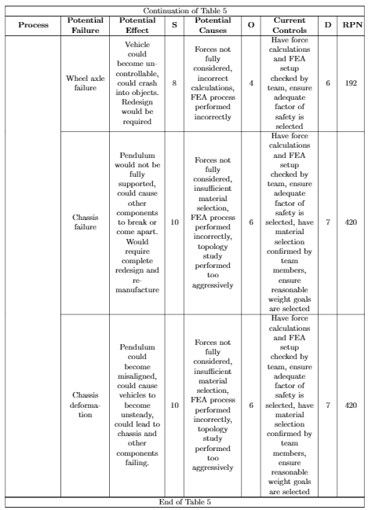
Highest severity failures
FAILURE MODE and EFFECT ANALYSIS

Slide 23
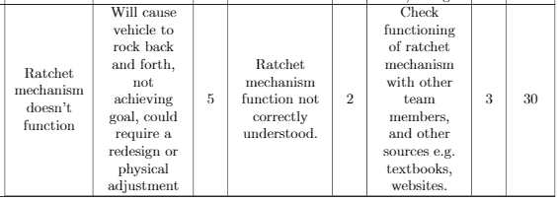

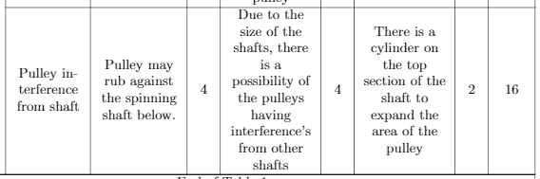
Low severity failures
FAILURE MODE and EFFECT ANALYSIS

Slide 24
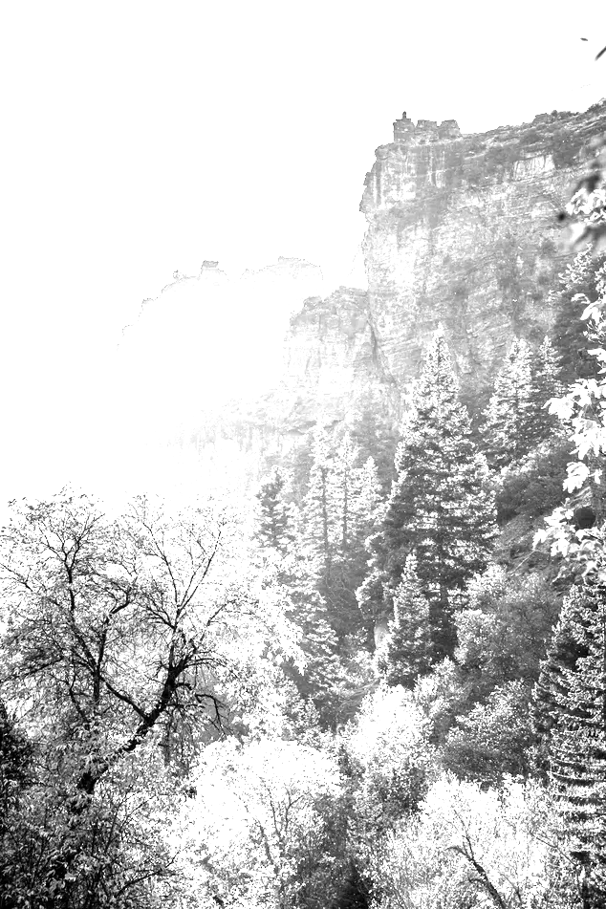
FINITE ELEMENT ANALYSIS
Material selection
Forces acting on the pendulum
Beam analysis
Ratchet gear forces

Slide 25

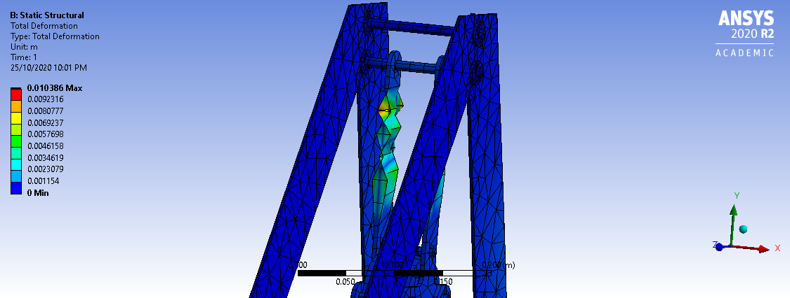
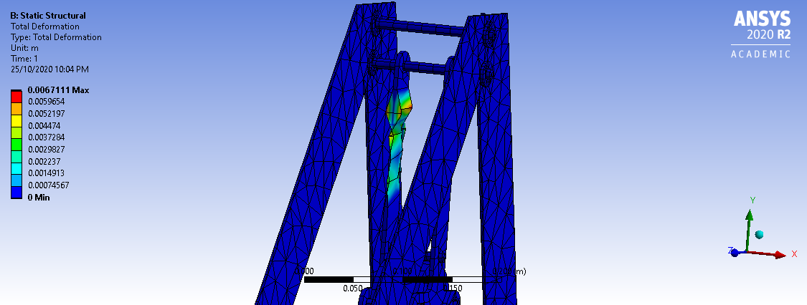
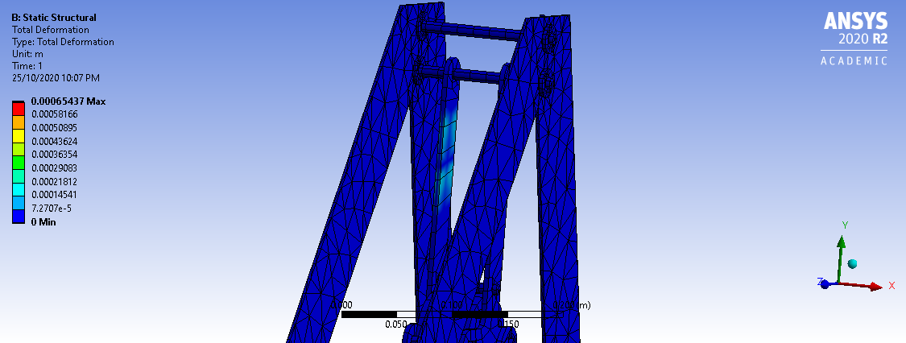
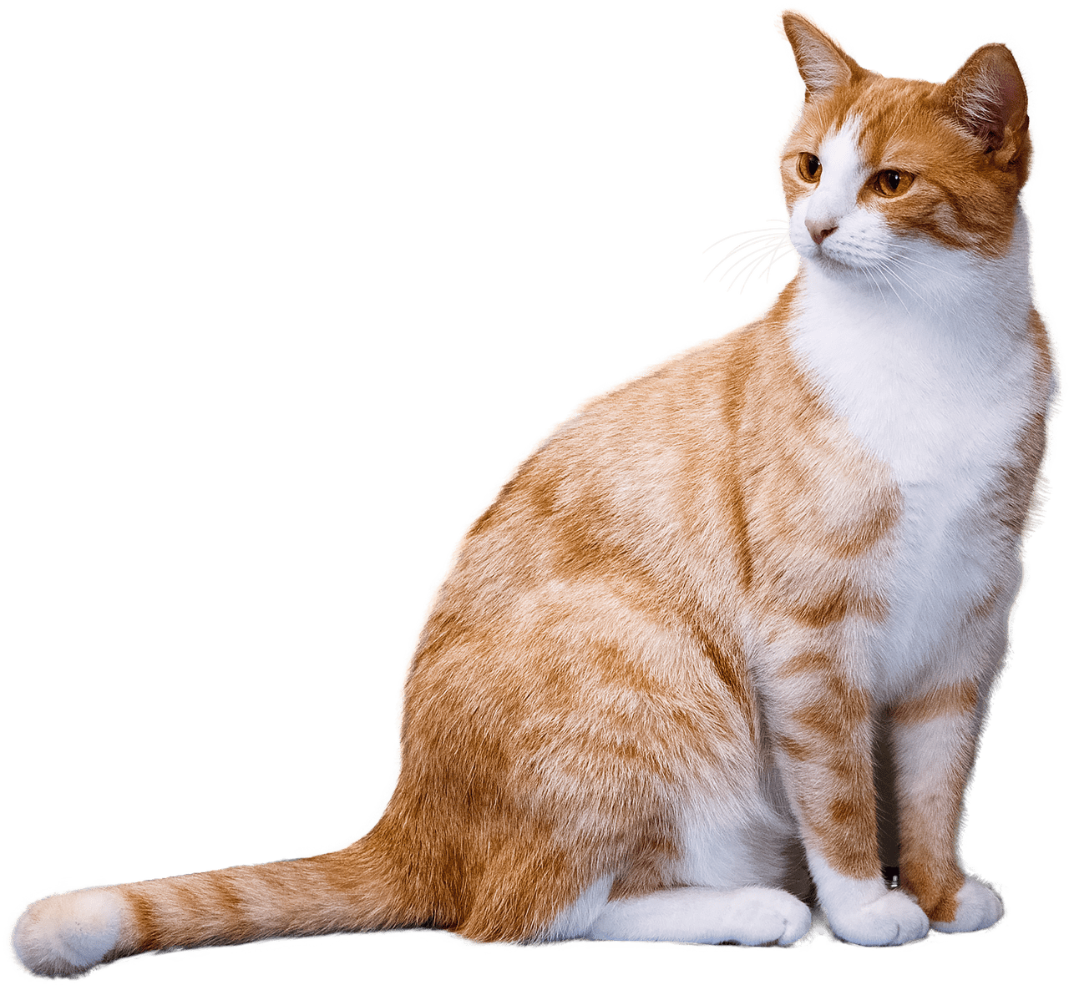
PVC Plastic
Oak Wood
FINITE ELEMENT ANALYSIS - Material selection
Stainless Steel 316
Weak material
Possibility of snapping
Bending of frame
Material is stretched by 10 mm
Does not deform easily
Strong, but may break
Not suitable for pendulum
Material is stretched by 6 mm
Strong, good ductility
Easy to manufacture with
Capable of holding 10kg mass without significant damage
Material stretched by 0.6mm

Slide 26
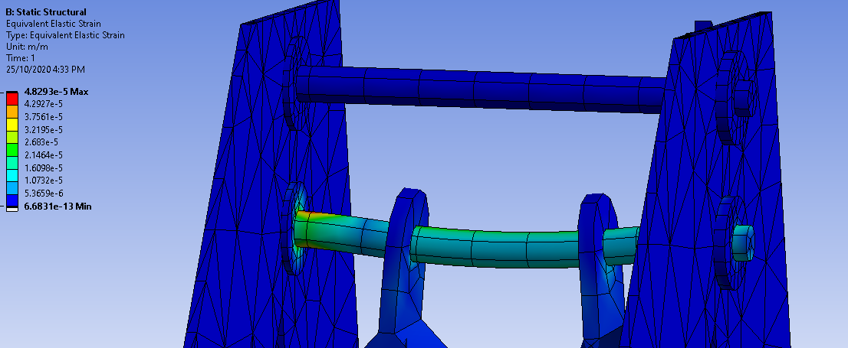

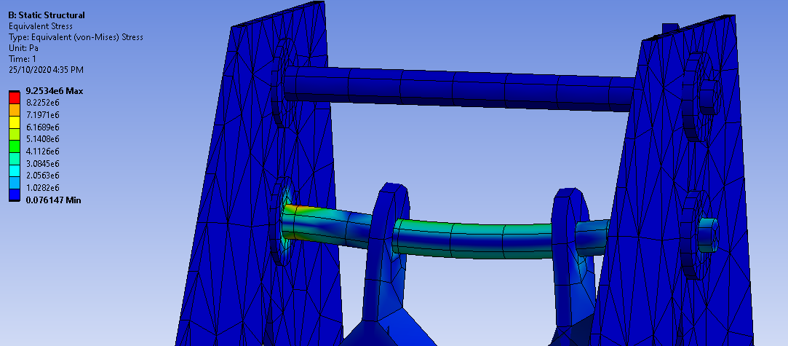
FORCES ON PENDULUM BEAM
Using Stainless Steel 316
Force of the weight at rest, acting on the beam. Tensile strength is 600 MPa, Yield strength is 290 MPa.
Top: Strain acting on beam,
Bottom: Stress acting on beam

Slide 27
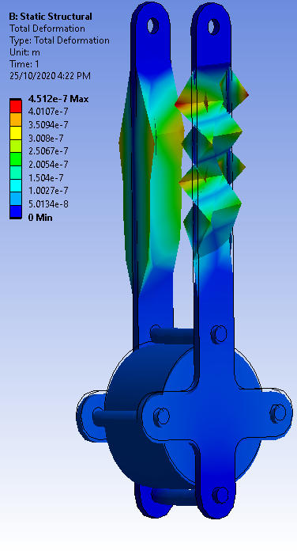
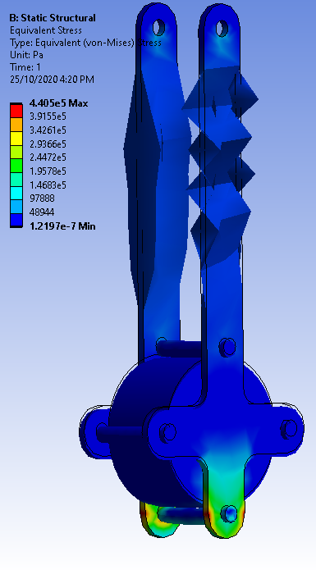


DEFORMATION
STRESS
STRAIN
Material: 316 Stainless steel
First image (left): Deformation of beam
Second (top): Strain on beam
Second (bottom): Maximal stress
VERY WAVY

Slide 28







FEA Teeth Meshing
Force of Strain acting on ratchet gears (m/m)
Stress acting on ratchet gears (pa)
Teeth are made using 316 stainless steel
Tensile strength is 600 MPa
Yield strength is 290 MPa

Slide 29
Video

Slide 30

FUTURE WORKS
Topology analysis for frame and gears to decrease weight
Reevaluation of goals - is innovation a priority?
Further dynamic analysis
Optimisation of ratchet gear dimensions to minimise backtracking

Slide 31


Thank you for listening!!!!!!!!!!!!!!

Slide 32
REFERENCES
Did you like the resources on this template? Get them for free at our other websites.
VECTORS
Usa map
Gradient logo with abstract shape
PHOTOS
Elevated view of road with trees growing in forest
Foggy weather in city with channel
American flag on brooklyn bridge in new york
Brightly illuminated city street
Blurred traffic lights on street at night
Road block signs closeup
Crosswalks in the city closeup
Manhattan bridge in new york
Contemporary buildings on waterfront of river
Brooklyn bridge over east river in new york
Motion in the city intersection
Architecture project and tablet mockup
Railways closeup with blurred background
Train on railway closeup
Man in black t-shirt standing in front of railway train
Portrait of a female architect writing on book at workplace
Portrait of smiling architect man holding cellphone and hard hat with blueprint at construction site
Elevated view of straight and curve road in forest

